Slide 1
Mutations
Dr. Muhammad Tahir
Assistant Professor
COMSATS University Islamabad,
Attock Campus

Slide 2
Protein synthesis summary
DNA
A
C
C
A
A
A
T
C
G
A
G
T
nucleus
transcription
U
G
G
U
U
U
A
G
C
U
C
A
mRNA
Cytoplasm:
ribosome
translation
Trp
Phe
Gly
Ser
PROTEIN

Slide 3
Think about it?
The sequence of bases in DNA are like the letters of a coded message.
What would happen if a few of those letters changed accidentally, altering the message?
What effects would you predict such changes to have on genes and the polypeptides for which they code?

Slide 4
Mutation
Mutations are changes in genetic information.
Now and then cells make mistakes in copying their own DNA, inserting the wrong base or even skipping a base as a strand is put together.
These variations are called mutations, from the Latin word mutare, meaning “to change.”

Slide 5
Definition: A mutation is…
A change in the arrangement of bases in an individual gene or in the structure of the chromosome (which changes the arrangement of genes).
A mutation is a change in the DNA sequence of an organism

Slide 6
Types of Mutations
All mutations fall into two basic categories:
Those that produce changes in a single gene are known as gene mutations.
Those that produce changes in whole chromosomes are known as chromosomal mutations.

Slide 7
Point Mutations
Replacement of nucleotides is called point mutation
Example ATATG → AGATG
Non-Sense Mutation
Mis-sense Mutation
Silent Mutation
Frameshift

Slide 8
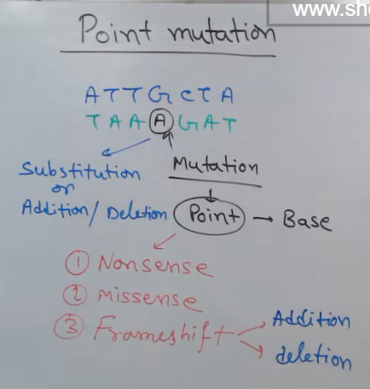
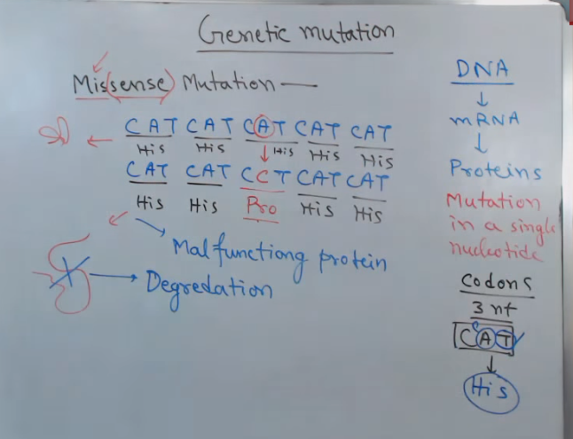
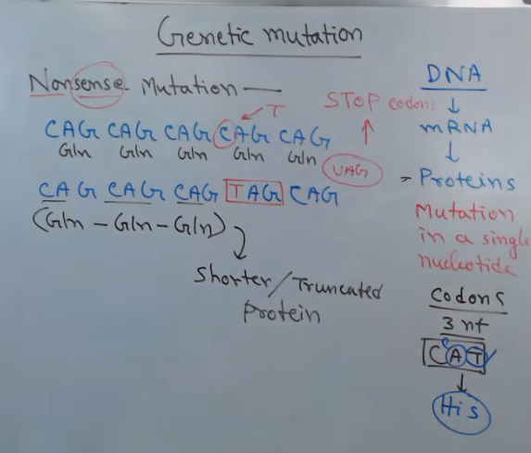
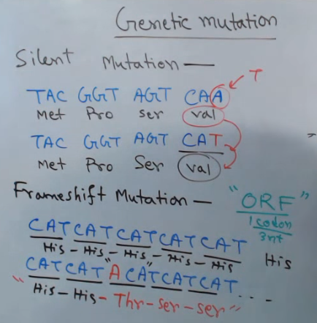

Slide 9
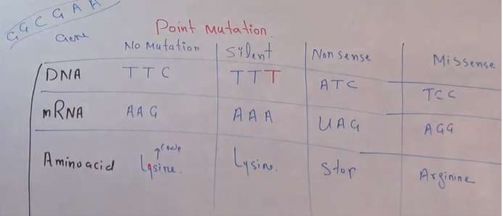
.
In point mutation there is change in the nucleotide.
In Silent mutation there is no change in amino acid after changing in dna.
Nonsense mutation changes an amino acid to stop codon.
In mismatch mutation causes changes in amino acid.
A frameshift mutation is a genetic mutation caused by a deletion or insertion in a DNA sequence.

Slide 10
Point mutations are caused by:
Changes in an individual gene due to miscopying of one or more nucleotides.
Deletion or insertion of a nucleotide results in a frameshift:
C A T G C G
A
T C A G A T
Codon 1
Codon 2
Codon 3
Codon 4
Arg
Ser
Leu
Tyr
Ala
Val

Slide 11
Point mutations
Substitution mutations result in a change of one base:
T
T A C G T G A A
A
C G G C A T
Met
His
Phe
Leu
Ala
Val

Slide 12
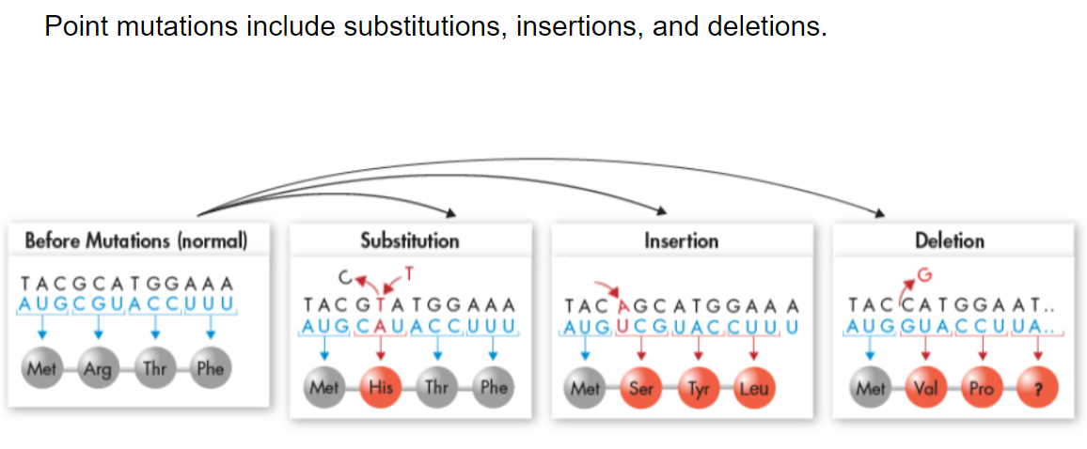
Point Mutation Example

Slide 13
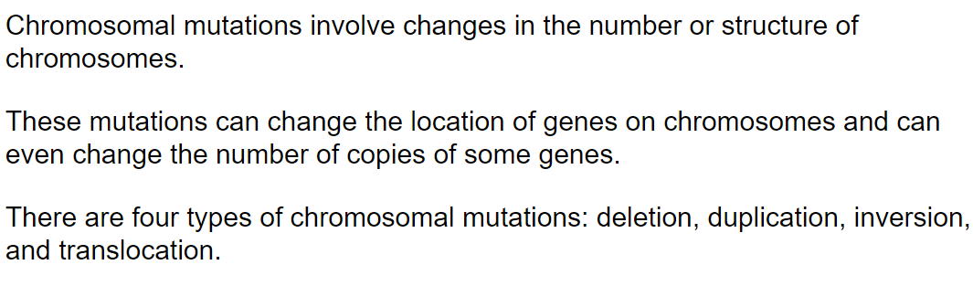
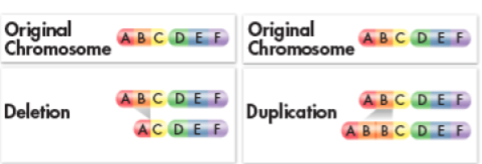
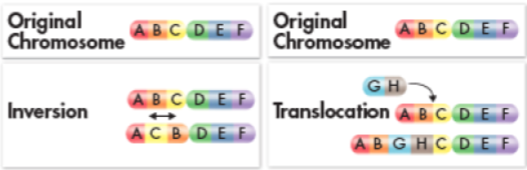
Chromosomal mutations

Slide 14
Chromosomal mutations
Gene deletion:
A
B
C
D
E
Gene duplication:
A
B
C
D
E
A
B
C
D
C
D
E

Slide 15
Chromosome mutations
Inversion:
A
B
C
D
E
Translocation:
A
B
C
D
E
X
W
Y
Z

Slide 16
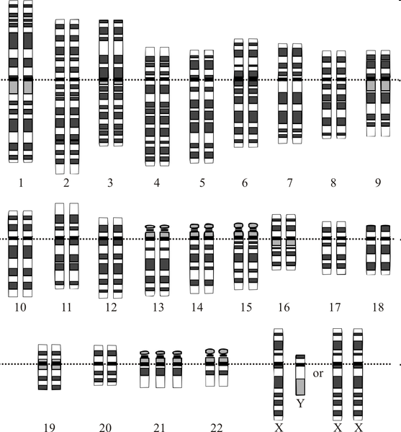
Whole-chromosome mutations
An entire chromosome is lost or repeated during cell division.
Example: Downs syndrome is caused by having an extra chromosme 21.

Slide 17
The effect of mutations
Genetic material can be altered by natural events or by artificial means.
The resulting mutations may or may not affect an organism.
Some mutations that affect individual organisms can also affect a species or even an entire ecosystem.

Slide 18
The effect of mutations
Many mutations are produced by errors in genetic processes.
For example, some point mutations are caused by errors during DNA replication.
The cellular machinery that replicates DNA inserts an incorrect base roughly once in every 10 million bases.
Small changes in genes can gradually accumulate over time.

Slide 19
The effect of mutations
Production of new/superior protein: Results: gain of reproductive advantage
Neutral mutation: Result: No change
Production of inferior or no protein: Result: Fatal and/or disease causing.

Slide 20
Causes of mutations
Some mutations arise from mutagens, chemical or physical agents in the environment.
Chemical mutagens include certain pesticides, a few natural plant alkaloids, tobacco smoke, and environmental pollutants.
Physical mutagens include some forms of electromagnetic radiation, such as X-rays and ultraviolet light.

Slide 21

Causes of mutations
Mutagens such as: X-rays ionising radiation chemicals

Slide 22
END

